Slide 1
LAI
LAND ECONOMICS WEEKEND
PHILADELPHIA
April 27-29, 2017

Slide 2
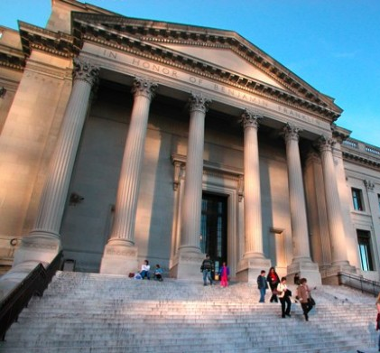
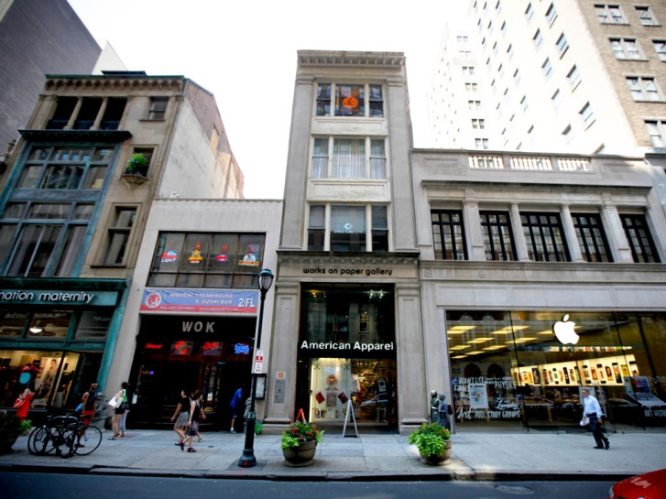
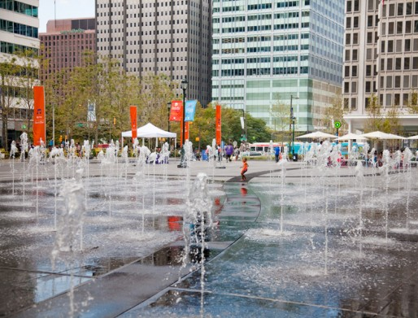
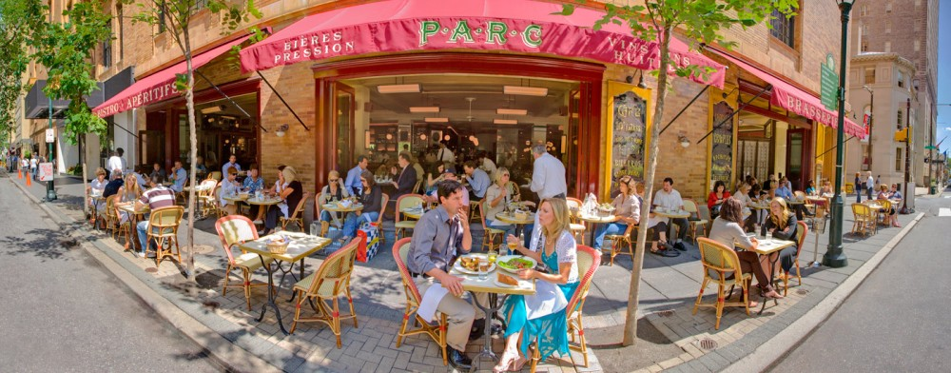
A Great Time to Visit Philadelphia...
One of America's Greatest Eating Cities -- Bon Appetite
No. 1 Most Exciting Place to See in the U.S. in 2016 -- Lonely Planet
Fastest Growing Population of Millennials among 10 largest U.S. Cities -- U.S. Census Bureau
Best City for Millennials -- Forbes survey, 2016
Top Place to visit in the U.S. -- NY Times list of 52 Places to Visit in 2015
First World Heritage City in the U.S. -- Selected by Organization of World Heritage Cities in 2015
No. 2 Best Shopping City -- Conde Nast Traveler, 2015 Reader's Choice Awards
One of Top Food Cities of 2015 -- Zagat

Slide 3
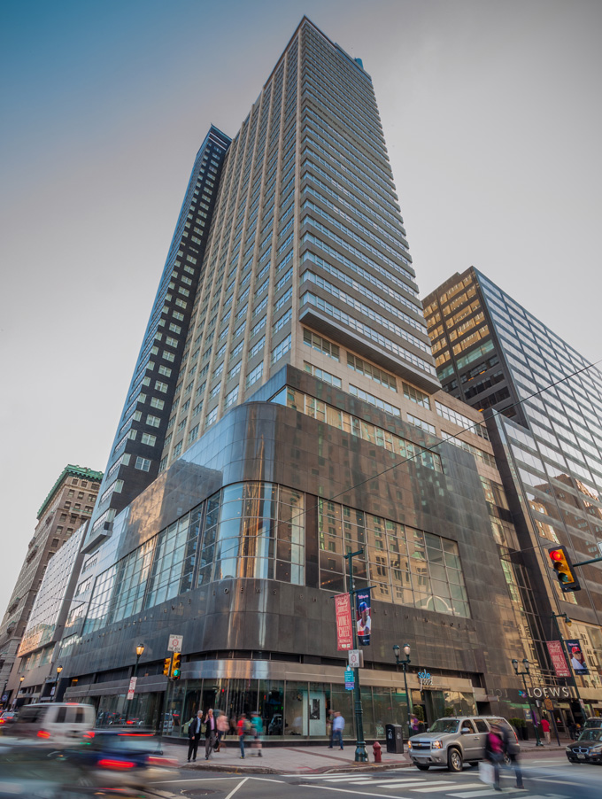
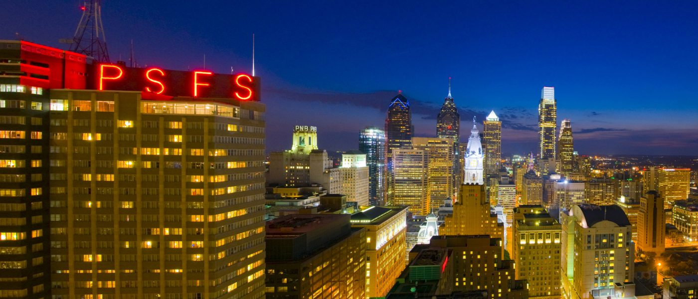
Host Hotel:
LOEWS Philadelphia Historic PSFS Building

Slide 4
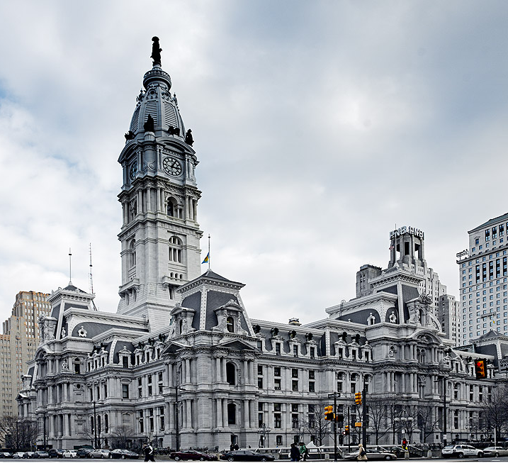
THURSDAY
Philadelphia:
Past, Present and Future
Walking Tour around Philadelphia's City Hall and Center Square

Slide 5
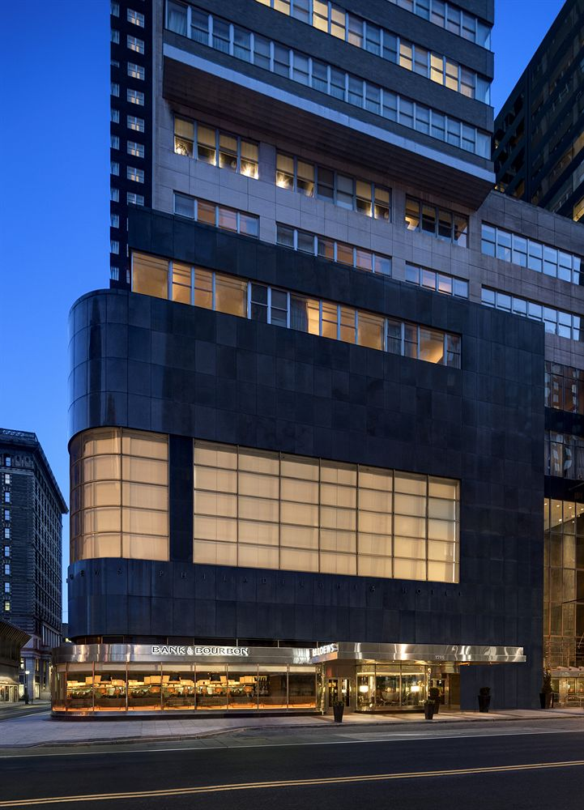
THURSDAY
PRESIDENT’S RECEPETION
33rd Floor Boardroom
LOEWS

Slide 6
FRIDAY
BRIDGING THE SCHUYLKILL RIVER

Slide 7
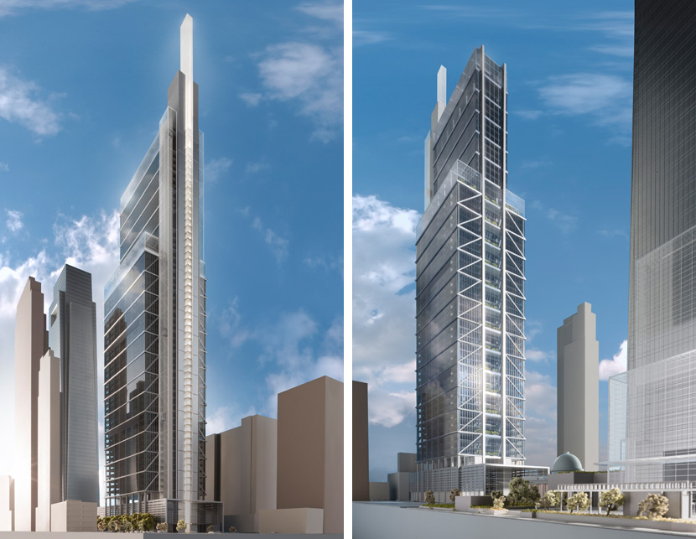
FRIDAY
COMCAST INNOVATION
AND TECHNOLOGY CENTER

Slide 8
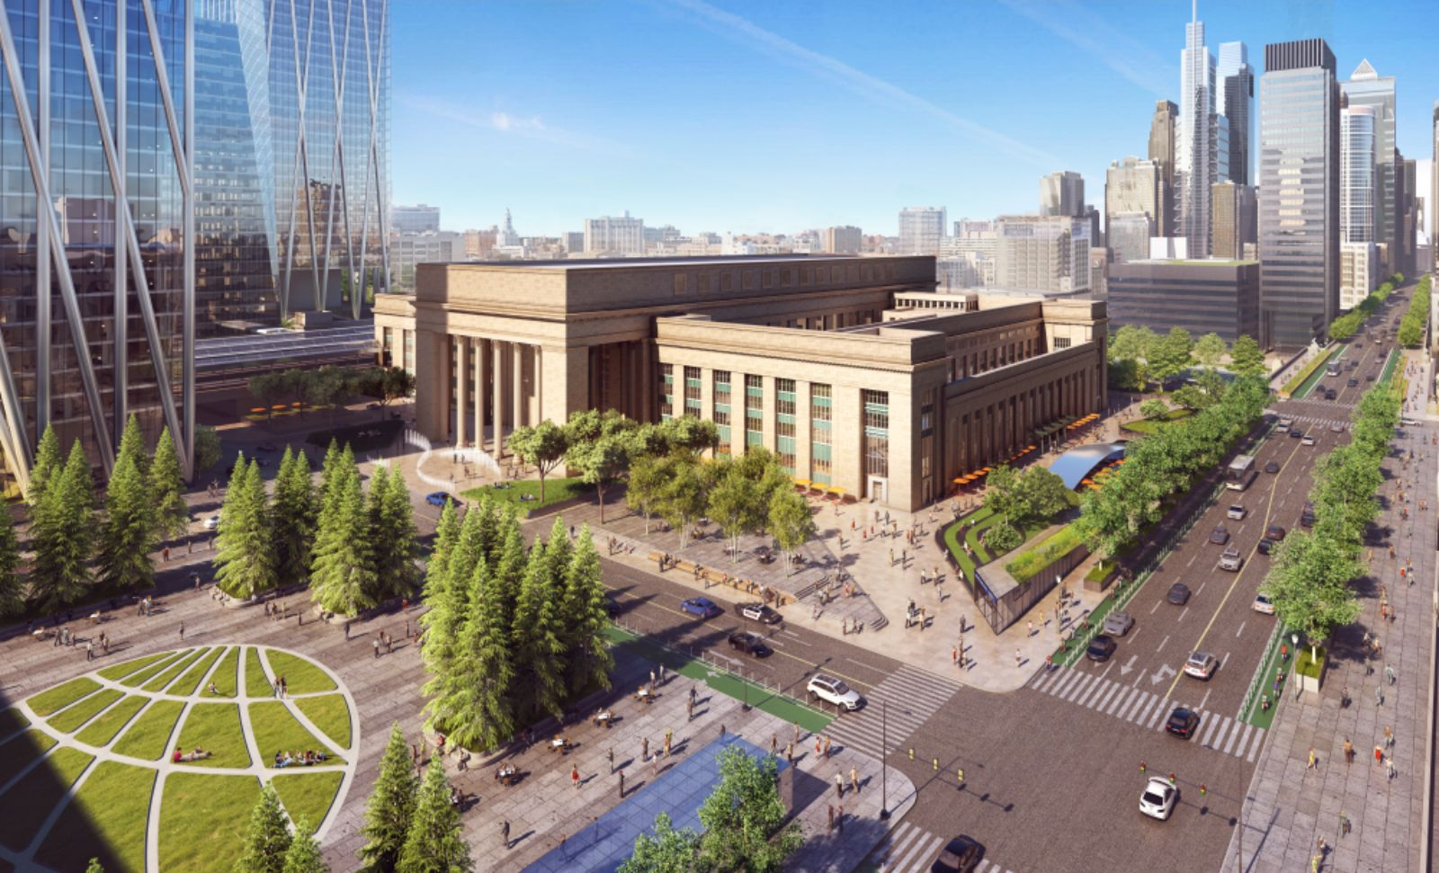
FRIDAY
Lunch Presentation:
30th Street Station Master Plan

Slide 9
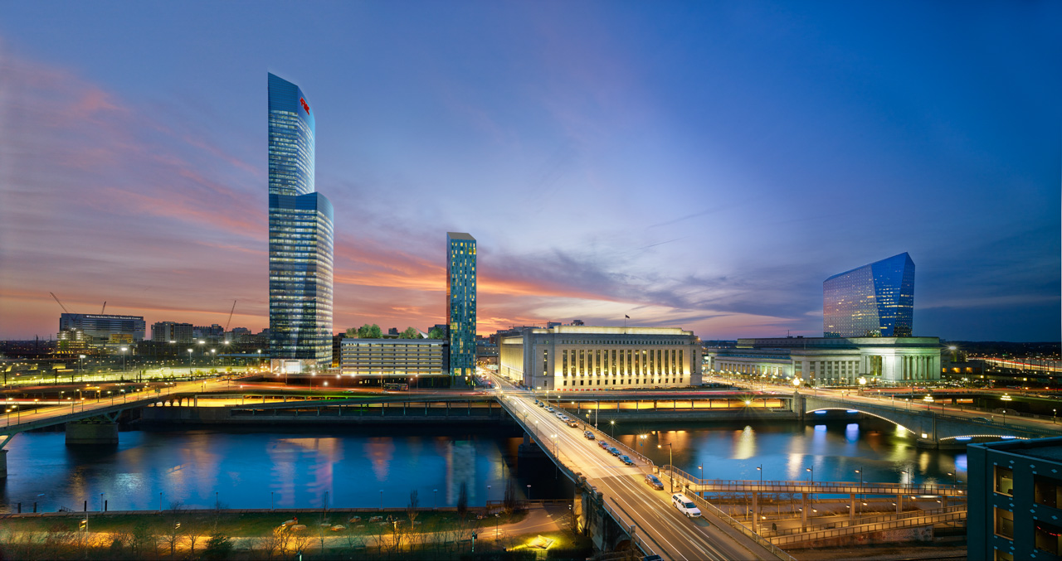
FRIDAY
CIRA Center Complex

Slide 10
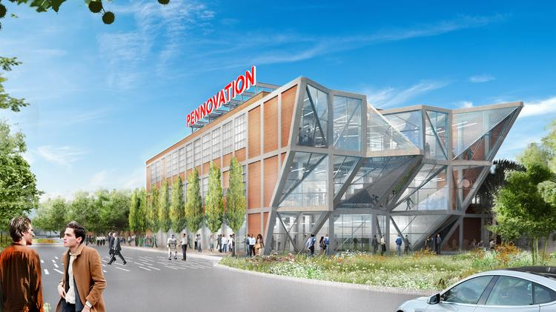
FRIDAY
PENNOVATION

Slide 11
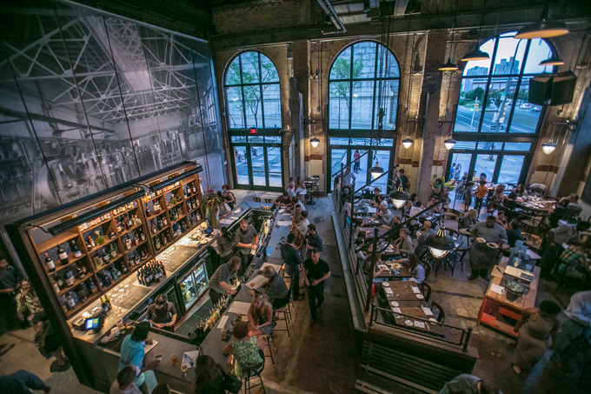
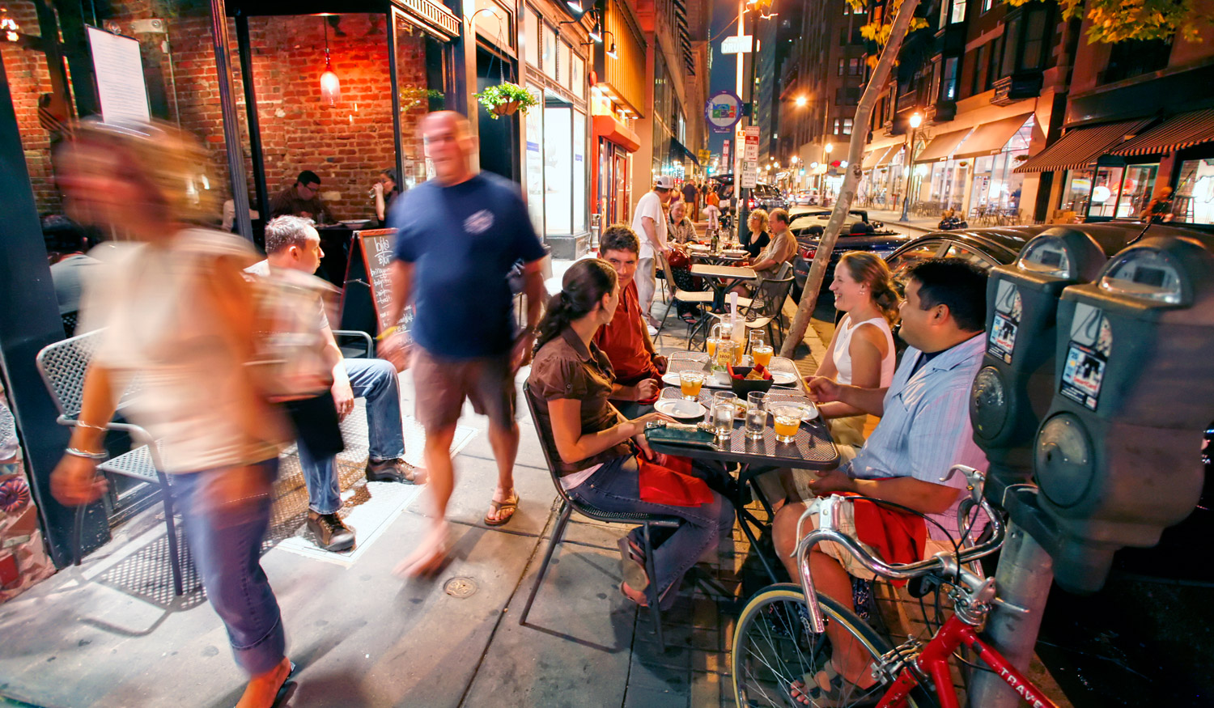
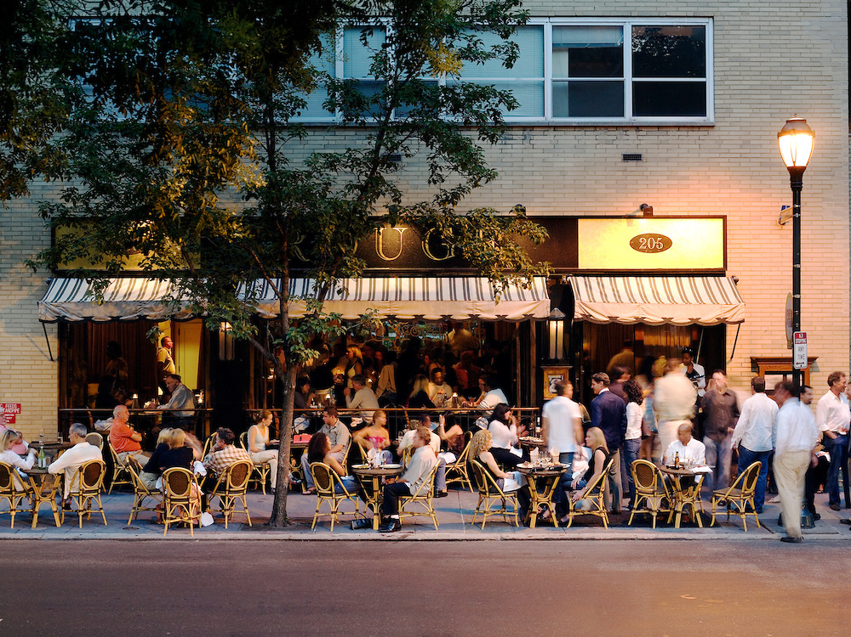
Dine-Around at Philly's Top Restaurants

Slide 12
SATURDAY
Bold Urban Revitalization Plans

Slide 13
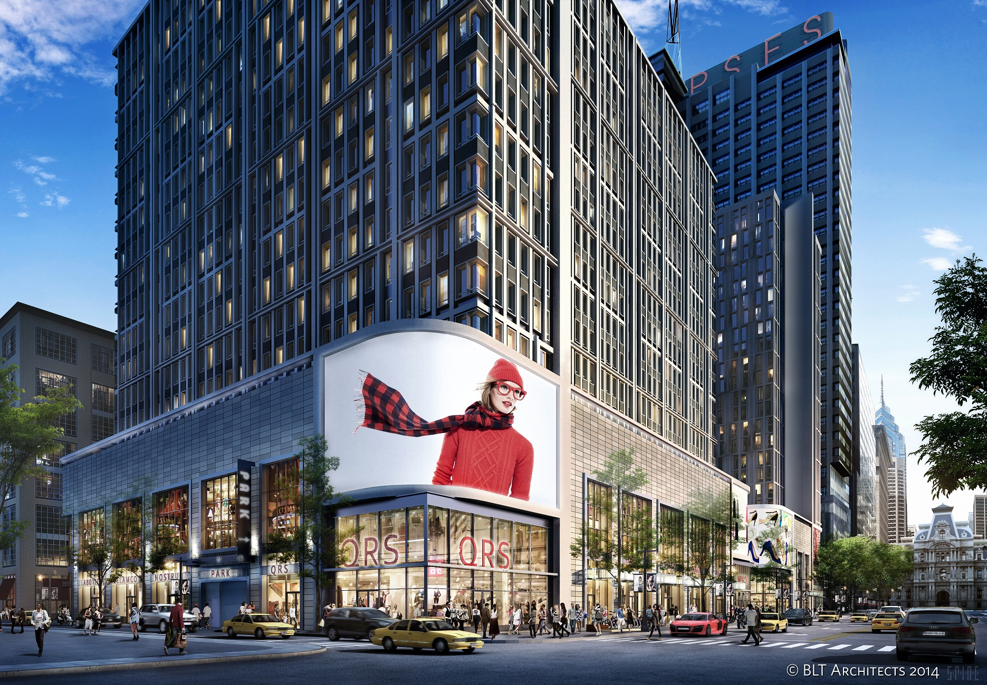
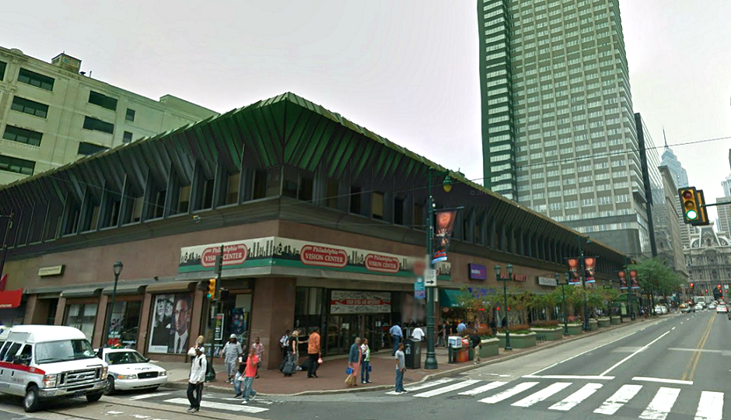
SATURDAY
MARKET EAST

Slide 14
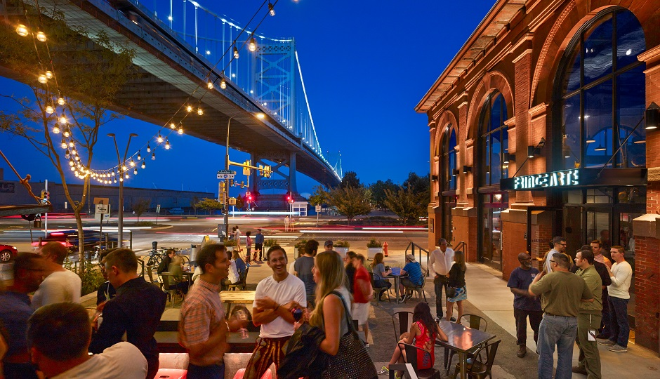
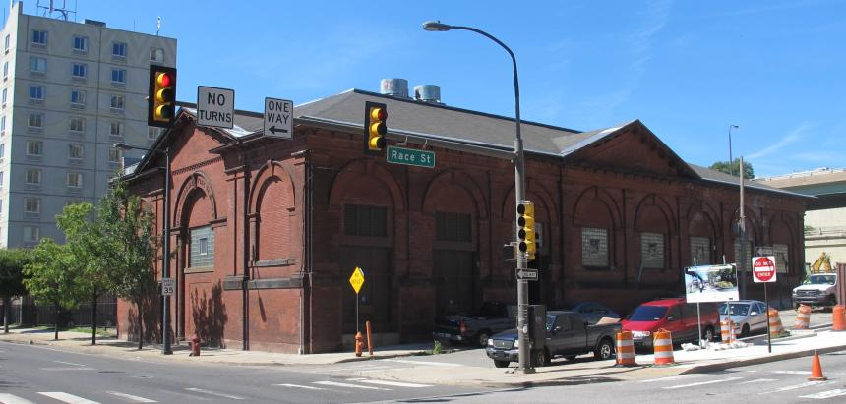
SATURDAY
FRINGEARTS

Slide 15
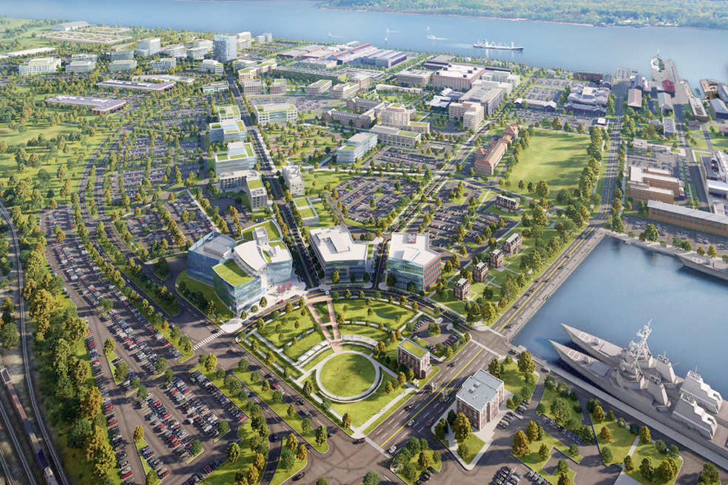
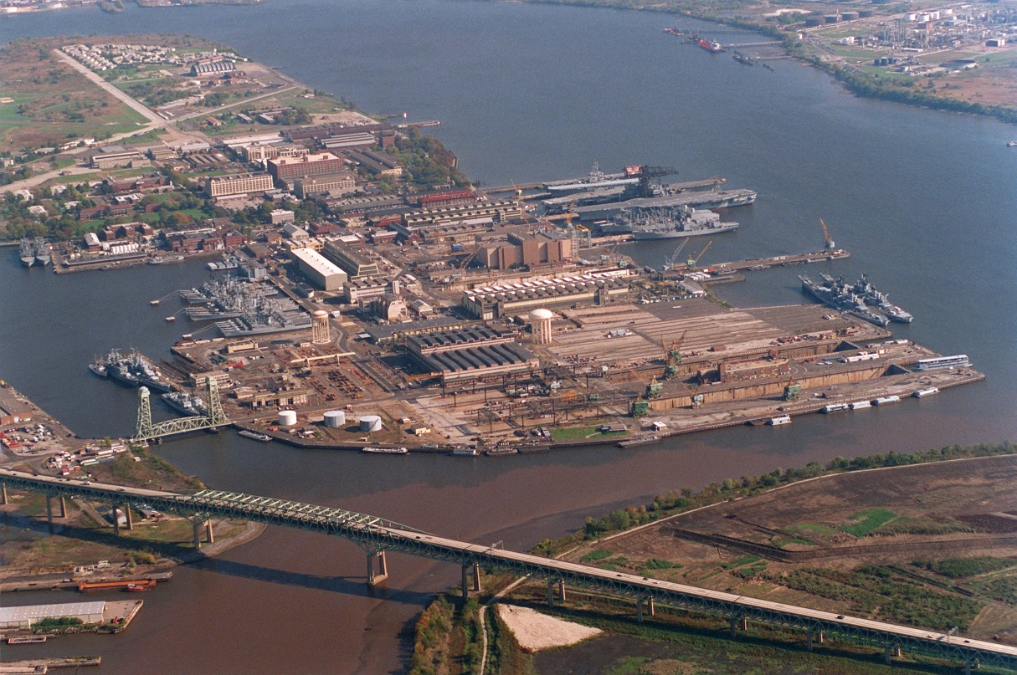
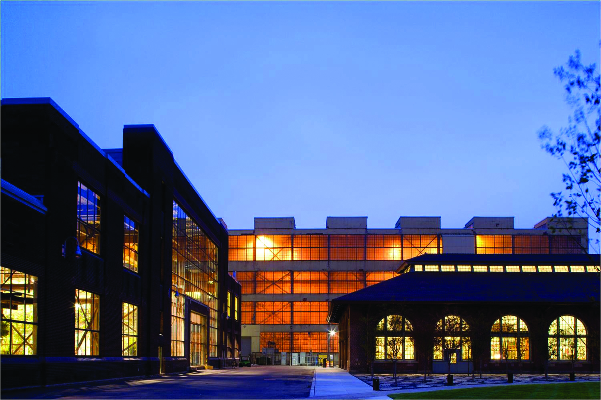
SATURDAY
NAVY YARD

Slide 16
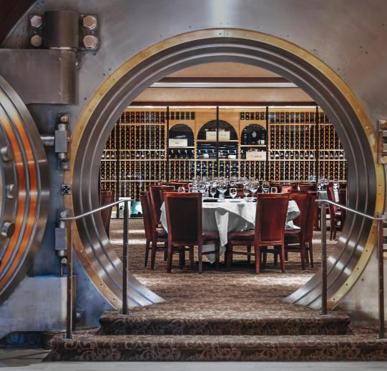
SATURDAY
LAI AWARDS
DINNER
DEL FRISCO'S VAULT ROOM
HISTORIC PACKARD BUILDING

Slide 17
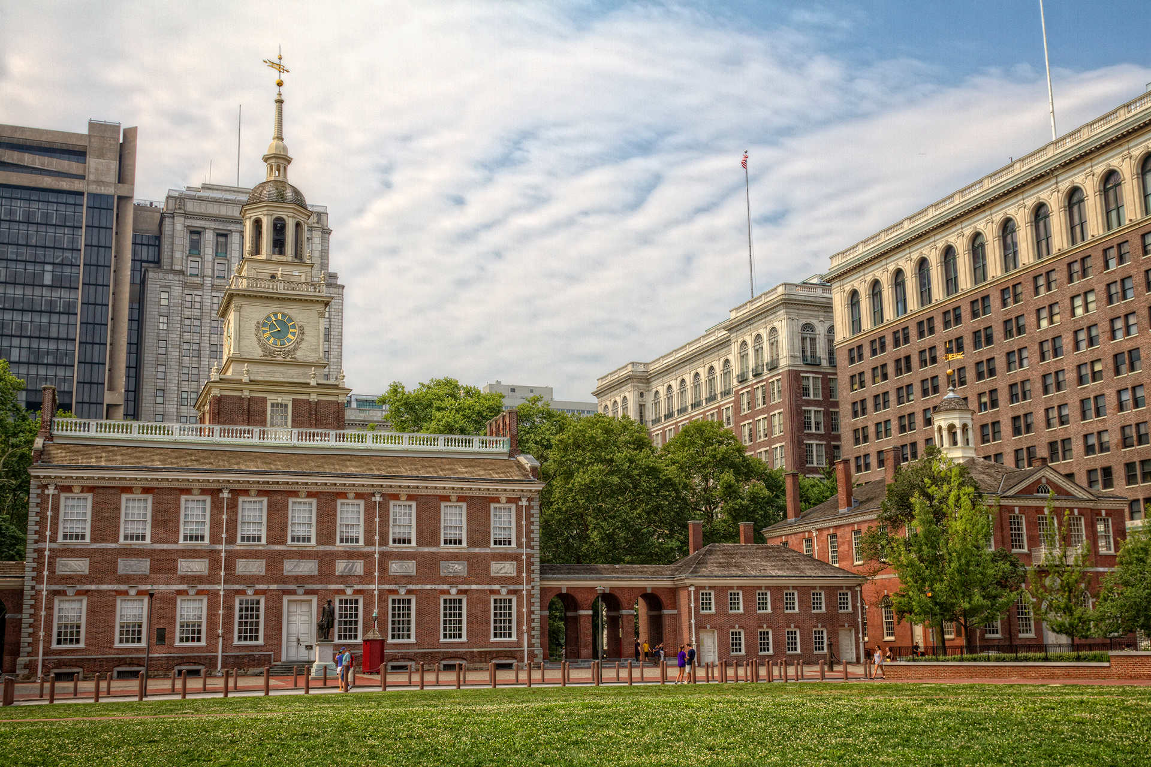
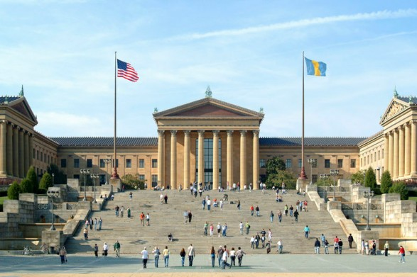
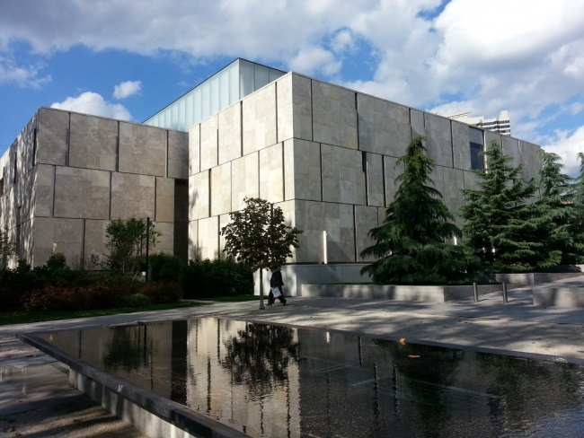
EXTEND YOUR STAY!
INDEPENDENCE NATIONAL HISTORIC PARK
PHILADELPHIA MUSEUM OF ART
THE BARNES MUSEUM

Slide 18
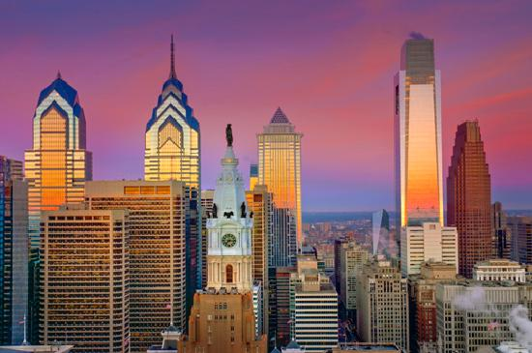
JOIN US
APRIL 27-29, 2017

