Slide 1
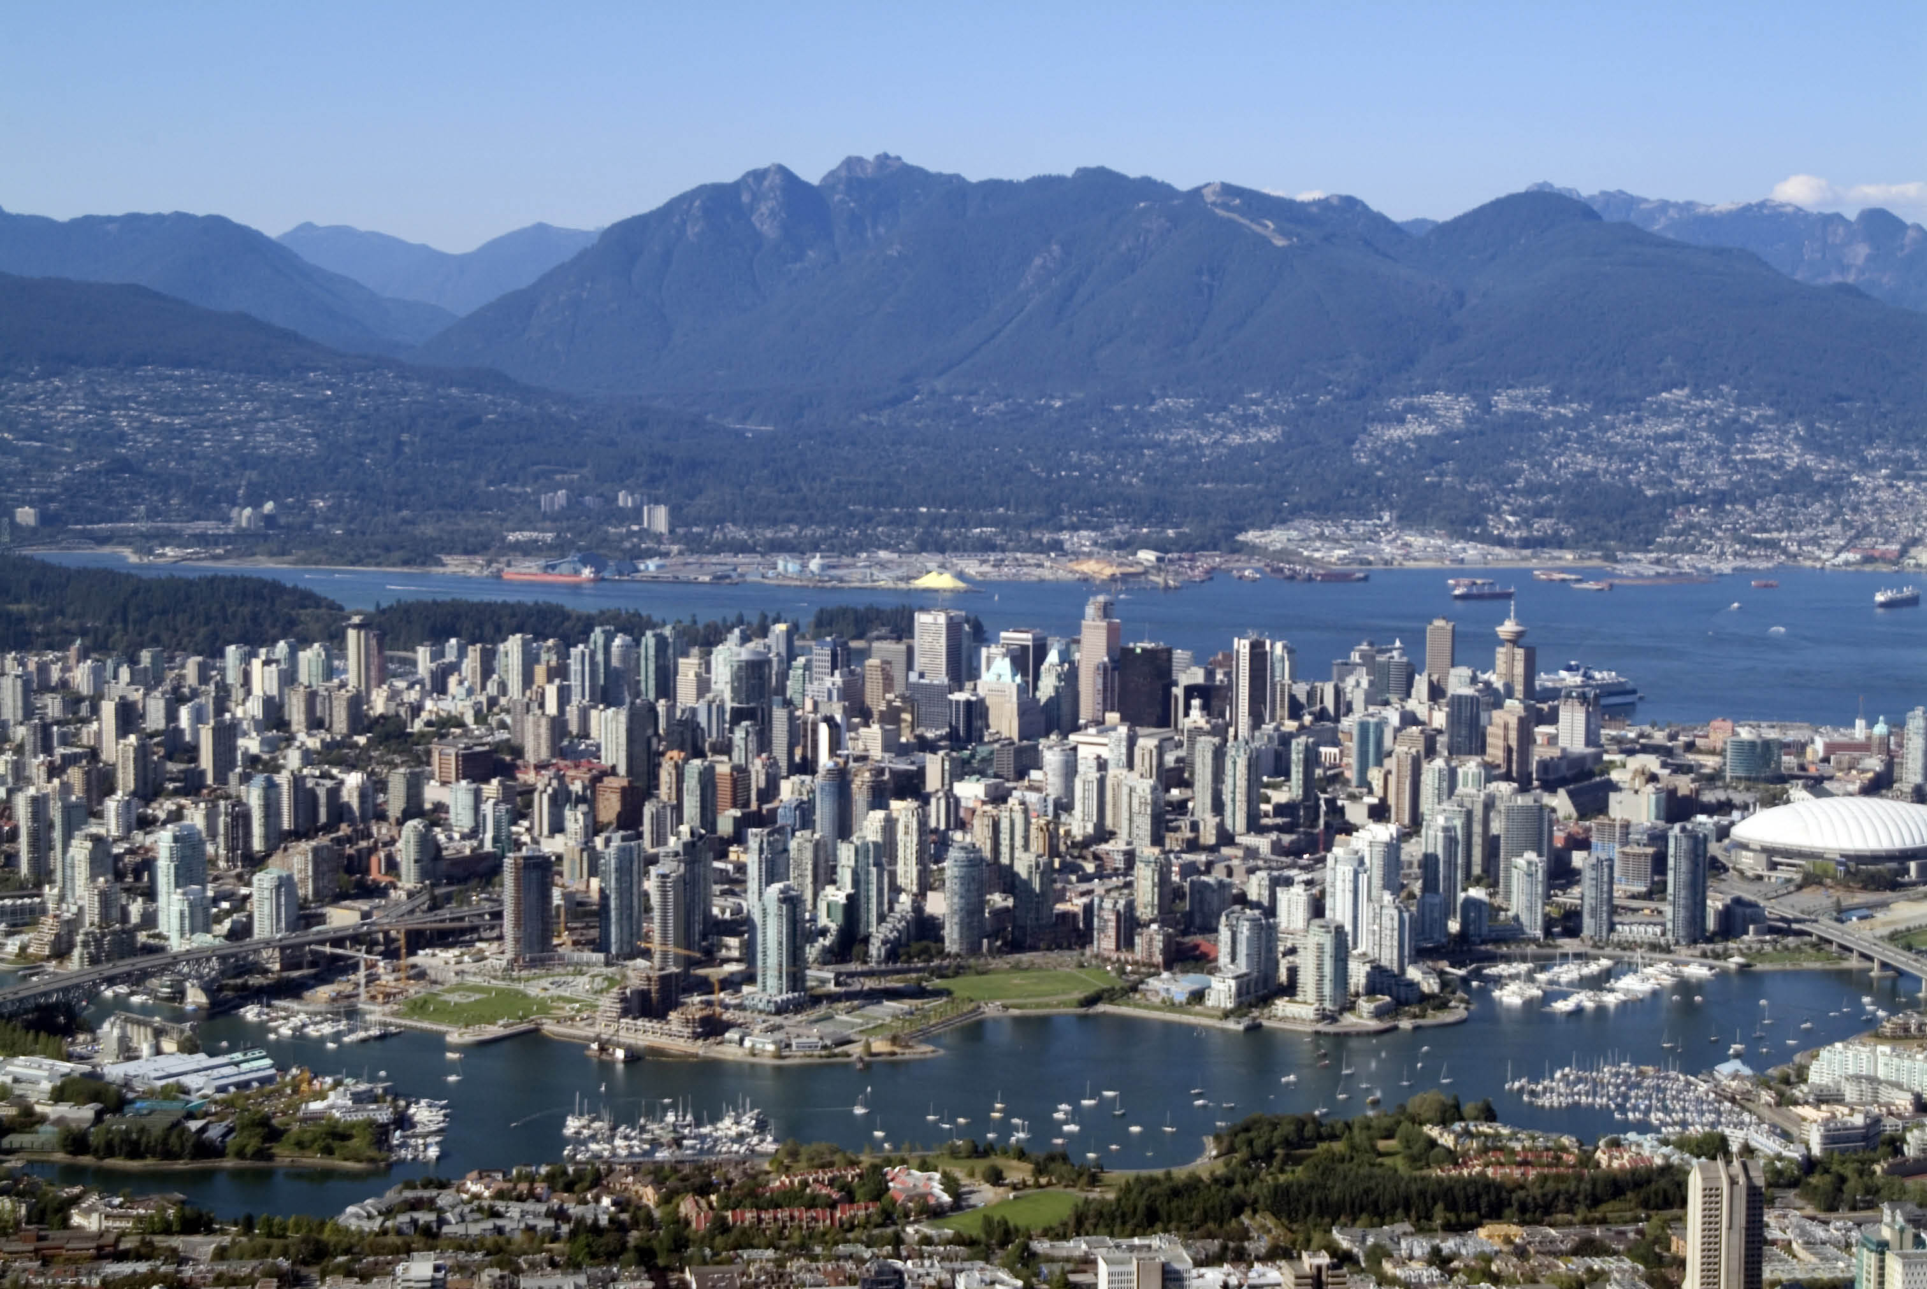
Vancouver Land Economics Weekend September 14-16, 2017

Slide 3
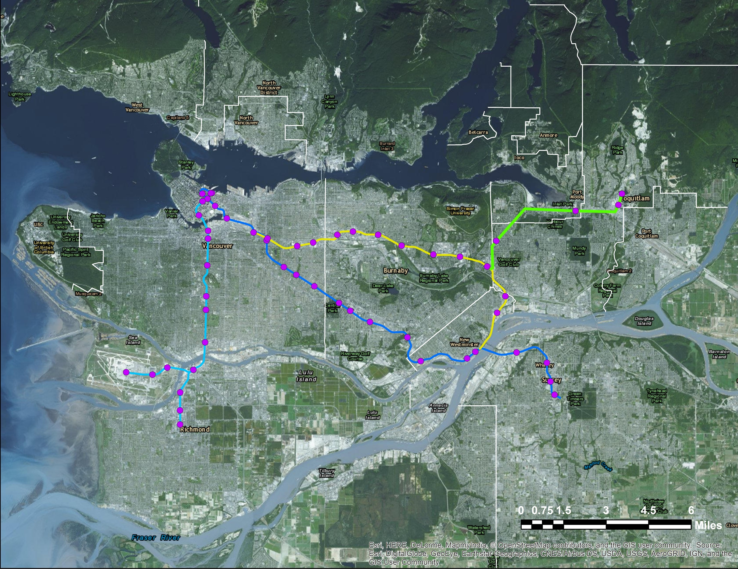
Vancouver LAI Weekend
DAY 2
DAY 1

Slide 4
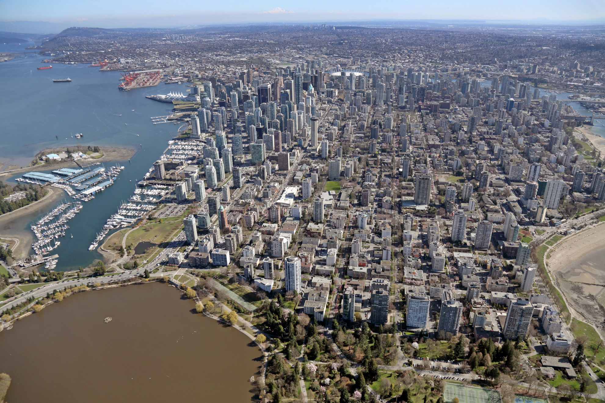
Source: Waite AirPhotos

Slide 5
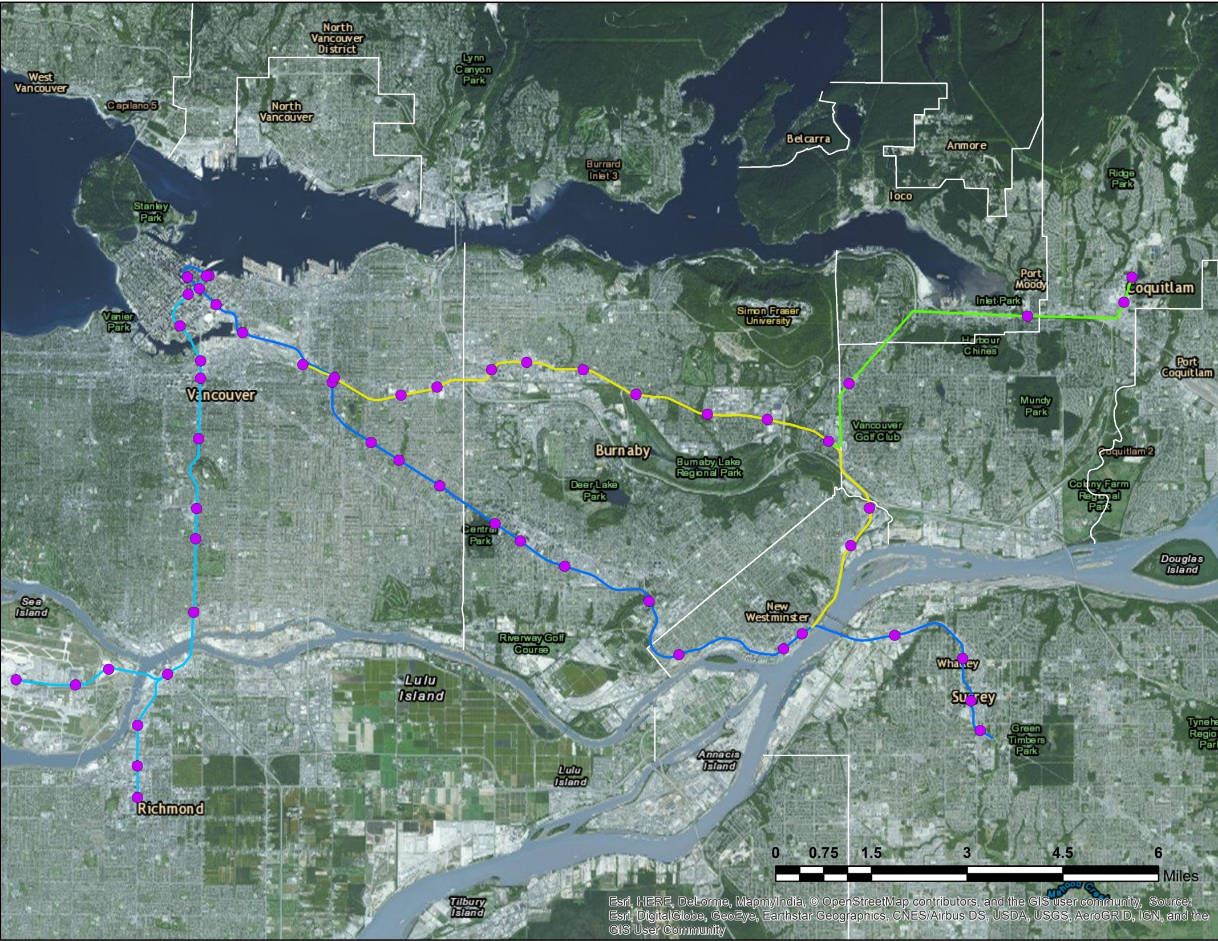
Vancouver LAI Weekend
1
Four Seasons Hotel
2
Brentwood Centre
3
Lougheed Centre
4
UniverCity
1
5
5
Coquitlam Regional
Town Centre
4
2
3

Slide 6
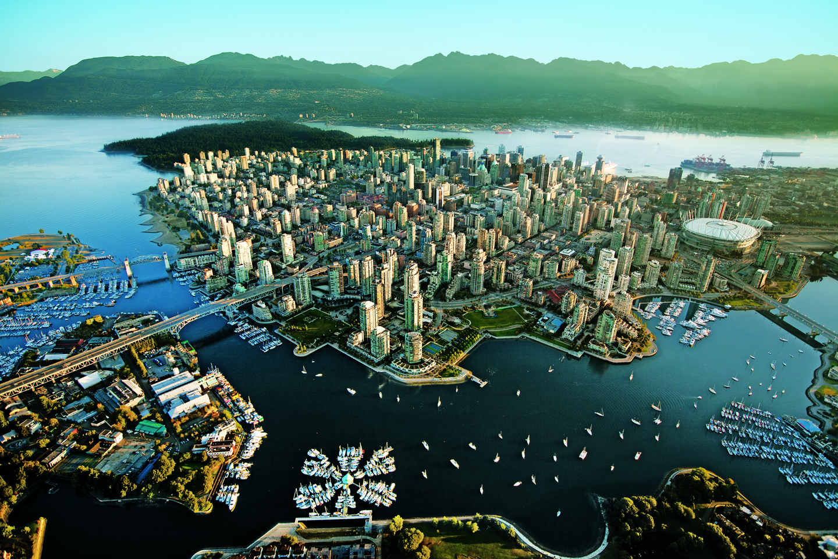
Source: UBC

Slide 7
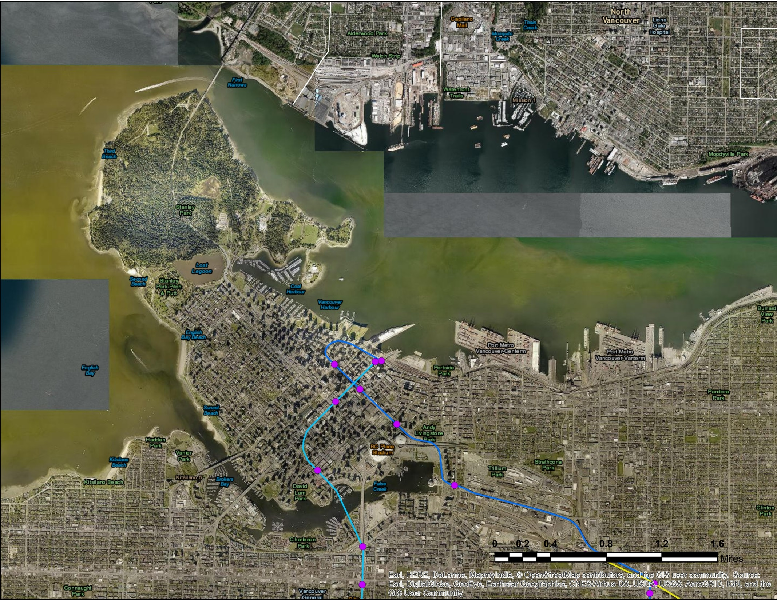
Vancouver LAI Weekend
1
Four Seasons Hotel
2
Granville Island
4
3
Boat Tour
4
North Vancouver
6
5
Sea Bus
5
6
Aquarium
1
2
3

